Slide 1
ICT Fundamentals
Bilal Rauf

Slide 2
Course Information
Text Books
  Computer Fundamentals by P. K. Sinha
Reference
  internet

Slide 3
Course Outline
Overview of Computer System
Number Systems
Input & Output Devices
Storage Devices
Data Communication and Computer Networks
Computer Software and Operating Systems
Database
Internet

Slide 4
Grades
Theory
  Quizzes ---------------10%
  Assignments---------10%
  Mid Term-------------- 30%
  Final-------------------- 50%
Labs
  Assignments and Project--------- 50%
  Mid term------------------------------ 20%
  Final----------------------------------- 30%

Slide 5
Introduction to Computer and Computer Systems
Lecture 1

Slide 6
What is a Computer
A computer is an electronic device, operating under the control of instructions (software) stored in its own memory unit, that can accept data (input), manipulate data (process), and produce information (output) from the processing. Generally, the term is used to describe a collection of devices that function together as a system.
A computer is an electronic device that can accept input, process it and produce results as its output.
A computer is an electronic device that process data according to the set of stored instructions.

Slide 7
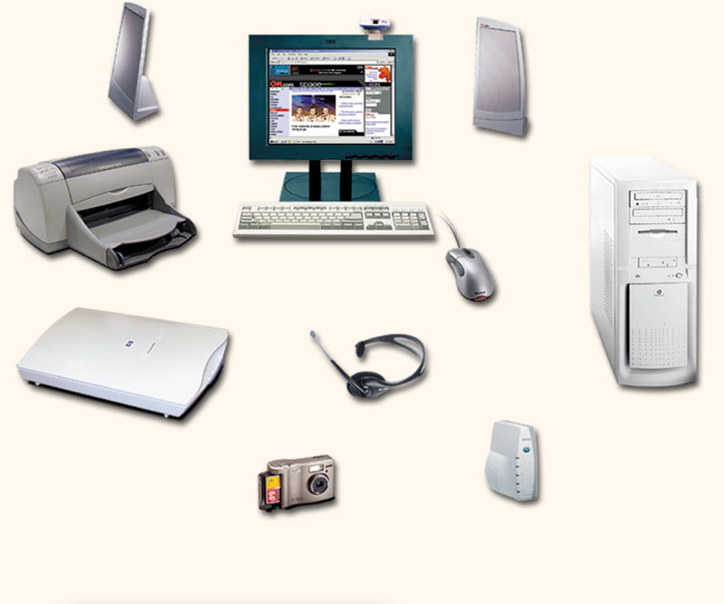
Devices that comprise a computer system
Monitor (output)
Speaker (output)
System unit
(processor, memory…)
Printer (output)
Storage devices
(CD-RW, Floppy, Hard disk, zip,…)
Mouse (input)
Scanner (input)
Keyboard (input)

Slide 8
What Does A Computer Do?
Computers can perform four general operations, which comprise the information processing cycle.
Input
Process
Output
Storage

Slide 9
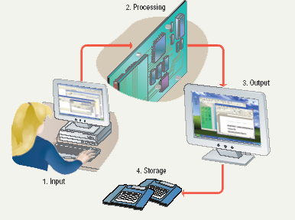
Information Processing Cycle
A computer converts data into information by performing various action on the data
Steps followed to process data
  Input
  Processing
  Output
  Storage

Slide 10
Data and Information
All computer processing requires data, which is a collection of raw facts, figures and symbols, such as numbers, words, images, video and sound, given to the computer during the input phase.
Computers manipulate data to create information. Information is data that is organized, meaningful, and useful.
During the output Phase, the information that has been created is put into some form, such as a printed report.
The information can also be put in computer storage for future use.

Slide 11
Data Vs Information
Data – raw facts
  06/01/1999 – a date
Information – data that have a particular meaning within a specific context
  06/01/1999 the date an automobile was sold

Slide 12

Data vs. Information
DATA
Processing
Raw Facts
Hours Worked
Pay Scale
Overtime def
Overtime Scale
Applying Knowledge Base
INFO
Useful, valuable Facts:
Total Paycheck

Slide 13
Why Is A Computer So Powerful?
The ability to perform the information processing cycle with amazing speed.
Reliability (low failure rate).
Accuracy.
Ability to store huge amounts of data and information.
Ability to communicate with other computers.

Slide 14
How Does a Computer Know what to do?
It must be given a detailed list of instructions, called a compute program or software, that tells it exactly what to do.
Before processing a specific job, the computer program corresponding to that job must be stored in memory.
Once the program is stored in memory the computer can start the operation by executing the program instructions one after the other.

Slide 15
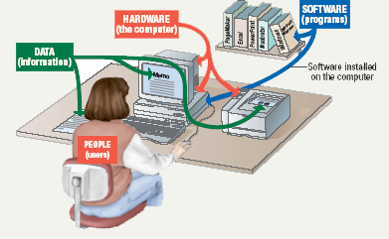
Parts of the Computer System
Computer systems have four parts
  Hardware
  Software
  Data
  User

Slide 16
Parts of the Computer System
Hardware
  Physical devices in the computer
  Anything that can be touched
Software
  Set of instructions that makes the computer to perform task
  It tells the computer what to do
  Also called a program

Slide 17
Parts of the Computer System
Data
  Individual facts or Pieces of information, that itself may not make sense to a person
  Computer job is to organize process and present meaningful data
Users
  People operating the computer
  Most important part
  Tell the computer what to do

Slide 18
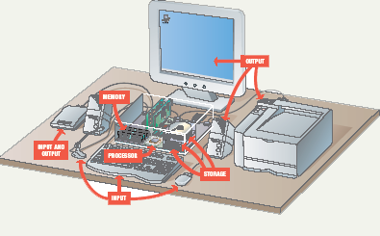
Essential Computer Hardware
Computers Hardware categorized into four basic types
  Processor
  Memory
  Input & output
  storage

Slide 19
Essential Computer Hardware
Processing devices
  The procedure that transforms raw data into useful information is called as processing
  To transform this information computer uses two components
    Processor
    Memory

Slide 20
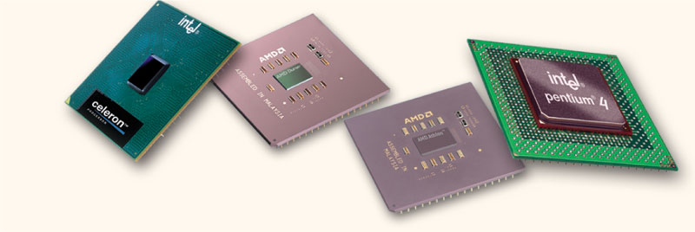
The Central processing Unit
The central processing unit (CPU) contains electronic circuits that cause processing to occur. The CPU interprets instructions to the computer, performs the logical and arithmetic processing operations, and causes the input and output operations to occur. It is considered the “brain” of the computer.

Slide 21
Essential Computer Hardware
Processor
  Brain of the computer
  Carries out instructions from users or the program
  A processor usually consists of one or more specialized chip “microprocessor”
  Manipulate the data
  Most computers have several processors
  Central Processing Unit (CPU) refers to processor
  Secondary processors

Slide 22
Essential Computer Hardware
Central Processing Unit (CPU)
  The CPU is then brain of the a computer system.
  The control unit (CU) & Arithmetic logic unit (ALU) of a computer system are jointly known as the CPU.
  In a computer system, all major calculations and comparisons are made inside the CPU.

Slide 23
Essential Computer Hardware
CPU
  Arithmetic Logic Unit
    ALU of a computer system is the place, where actual execution of the instruction takes place, during the processing unit.
    Almost all ALU are designed to perform the four basic arithmetic operations (add, subtract, multiply, and divide), and logical operations or comparisons , such as less than, equal to, and greater than.
  Control Unit
    It manages and coordinates the entire computer system.
    The CU acts as a central nervous system for the other components of the computer system.

Slide 24
Essential Computer Hardware
Memory devices
  One or more chips to Stores data or programs instructions
    Temporarily or permanently
  Two most important types are RAM & ROM
Random Access Memory (RAM)
  Holds data and program instructions while CPU is working
  Volatile, loses information when computer is off
  Stores current data and programs
  More RAM results in a faster system
Read Only Memory (ROM)
    Permanent storage of programs
    Holds the computer boot directions

Slide 25
Amount Of RAM In Computers
The amount of memory in computers is typically measured in kilobytes or megabytes. One kilobyte (K or KB) equals approximately 1,000 memory locations and one megabyte (M or MB) equals approximately one million locations. A memory location, or byte, usually stores one character.
Therefore, a computer with 8 MB of memory can store approximately 8 million characters. One megabyte can hold approximately 500 pages of text information.

Slide 26
Essential Computer Hardware
Input and output devices
  Allows the user to interact
  Input devices accept data
    Keyboard, mouse
  Output devices deliver data
    Monitor, printer, speaker
  Some devices are input and output
    Touch screens

Slide 27
Essential Computer Hardware
Storage devices
  Hold data and programs permanently
  Different from RAM
  Magnetic storage
    Floppy and hard drive
    Uses a magnet to access data
  Optical storage
    CD and DVD drives
    Uses a laser to access data

Slide 28
Categories of Computer
Computers can be categorized in several ways
  Some are designed for use by one person
  Some are meant to be used by group of people
  Some are not being used by people at all?
Computers are also categorized by their power
  Speed at which they operate
  Type of task they can handle

Slide 29
Categories of Computer
Four Categories of Computer
  Microcomputers
  Minicomputers
  Mainframes
  Supercomputers
Fast Expensive Complex Large
Super Computers
Mainframe Computers
Minicomputers
Microcomputer
Palmtop Computer
Calculator
Slow Cheap Simple Small

Slide 30
Microcomputers
Microcomputers often refer to as Personal computers (PCs).
Key Features
  Low Cost
  Good Range of Application Software
  User friendly
  Design to support one user at a time.

Slide 31
Minicomputers
Minicomputers are multi-terminal and multi-user systems.
Key features
  More expensive then microcomputers but cheaper than a mainframe.
  Requires more formal operation and management support than microcomputers
  Support many user simultaneously and many task simultanously.

Slide 32
Mainframes
Mainframes are used by large corporations such as banks, which have large amounts of data to process organized into big databases.
Key features
  Fast processing
  Large volumes of data
  Large primary storage
  Expensive

Slide 33
Supercomputers
Super computers are very large computers capable of handling massive volumes of data and performing hundreds of millions of complex calculations every seconds.
Complex scientific applications like weather forecasting, nuclear research etc., requires a large amount of calculations within a short time.

Slide 34
Computer For Individual Use
Microcomputer
Most computers are meant to be used by only one person at a time
  Such computers are often shared by many
Six primary types of computers in this category are:
  Desktop computers
  Workstations
  Notebook Computers
  Tablet computers
  Handheld computers
  Smart phones

Slide 35
Personal Computers
Known as “PC”- used by single person
  Also called as microcomputers
They can also be connected together to create a network
  Networking has become the most important job of personal computers

Slide 36
Computers For Individual Use
Desktop computers
  The most common type of computer
  Sits on the desk or table
  Performs a variety of tasks
    To communicate, produce music, edit photographs, play games
Workstations
  Specialized single user computers
  Optimized for science or graphics
  More powerful than a desktop
  Suitable for, engineering design, modeling, animation and video editing

Slide 37
Computers For Individual Use
Notebook computers
  Small portable computers
  Typically as powerful as a desktop
  Can include a docking station
    To be plugged in with large monitor, keyboard, mouse and other devices
  Fall into the category of mobile computers

Slide 38
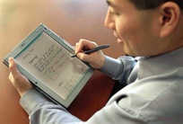
Computers For Individual Use
Tablet computers
  Newest development in portable computers
  Full featured computer, offers all the functionalities of notebook
  Input is through
  a pen called stylus or digital pen
  Run specialized versions of office products
  Can be connected to network

Slide 39
Computers For Individual Use
Handheld computers
  Very small computers
  Personal Digital Assistants (PDA)
  Note taking or contact management
  Data can synchronize with a desktop
Smart phones
  Hybrid of cell phone and PDA
  Web surfing, e-mail access

Slide 40
Computers For Organizations
Most organizations networks are based on PCs, which are connected to one or more centralized computers
Network servers
  Centralized and powerful computer with special software
  All other computers connect
  Provides access to network resources
  Multiple servers are called server farms
  Often simply a powerful desktop

Slide 41
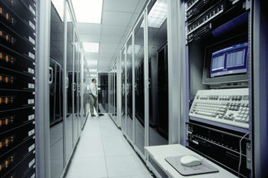
Computers For Organizations
Mainframes
  Used in large organizations
    Banks, airline etc
  Handle thousands
  of users accessing same data
  Users access through a terminal
    Dumb terminal: do not process or store only in/output
    Intelligent terminal: can perform some processing operations but do not store

Slide 42
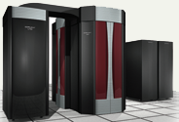
Computers For Organizations
Supercomputers
  The most powerful computers made
  Handle large and complex calculations
  Process trillions of operations per second
  Found in research organizations

Slide 43
Software Runs The Machine
Tells the computer what to do
Reason people purchase computers
Two types
  System software
    Any program that controls the computer hardware so that it runs efficiently
    Operating system
  Application software
    Tells the computer how to accomplish a specific task
      Word processing, spread sheet, Database management, presentation and graphic programs

Slide 44
Software Runs The Machine
System software
  Most important software
  Operating system
    Windows XP
  Network operating system (OS)
    Windows Server 2003
  Utility
    Symantec AntiVirus

Slide 45
Software Runs The Machine
Application software
  Accomplishes a specific task
  Most common type of software
    MS Word
  Covers most common uses of computers

Slide 46
Computer users
Role depends on ability
  Setup the system
  Install software
  Mange files
  Maintain the system
“Userless” computers
  Run with no user input
  Automated systems

